Slide 1
SuperQuantum Hack
Quantum Dores

Slide 2
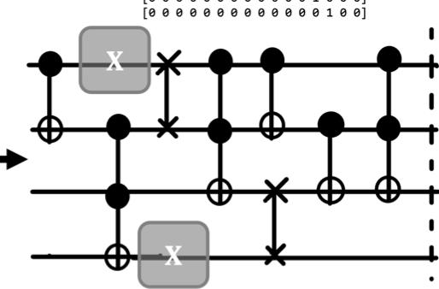
Approach - 1- Charles

Slide 3
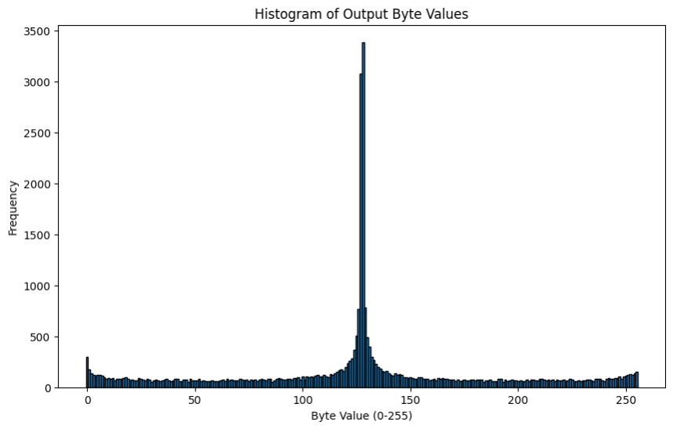
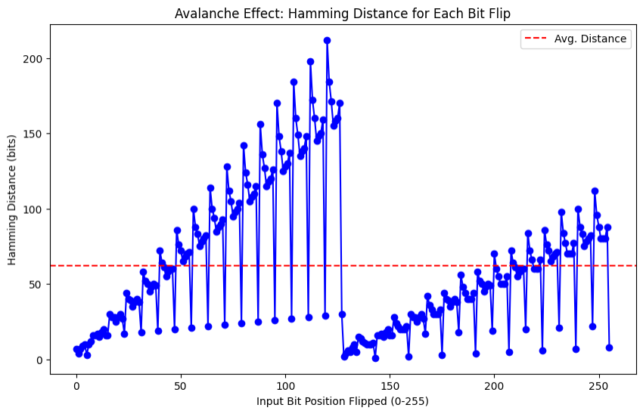
Approach - 2 - Kenny
Avg. Hamming Distance: 62 out of 256 bits
Computation Time: ~ 0.093 seconds per hash
Entropy: 7.05 bits per byte
Notes:
Average Hamming Distance: ~62 out of 256 bits This means that, on average, modifying one bit of the input changes ≈62\approx 62≈62 bits in the final hash output, suggesting a reasonable avalanche property.
Computation Time: ~0.093 seconds per hash The average time to generate a single hash is under a tenth of a second, which is not unreasonable for a quantum simulation.
Entropy: ~7.05 bits per byte An entropy of around 7.05 bits per byte is high, indicating the output distribution is relatively uniform.

Slide 4
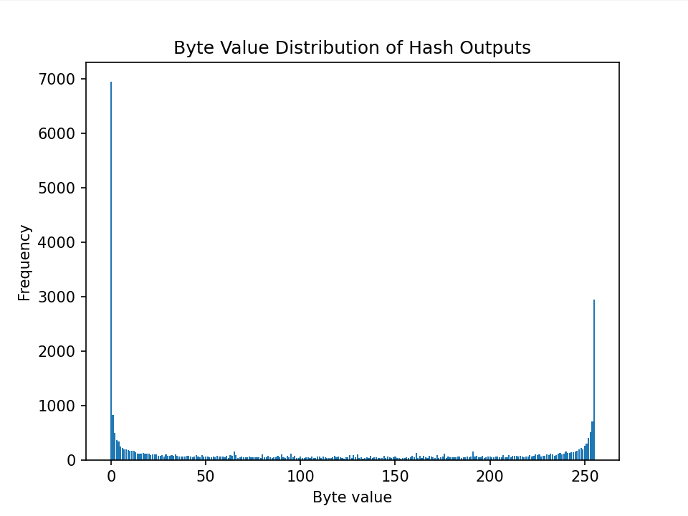
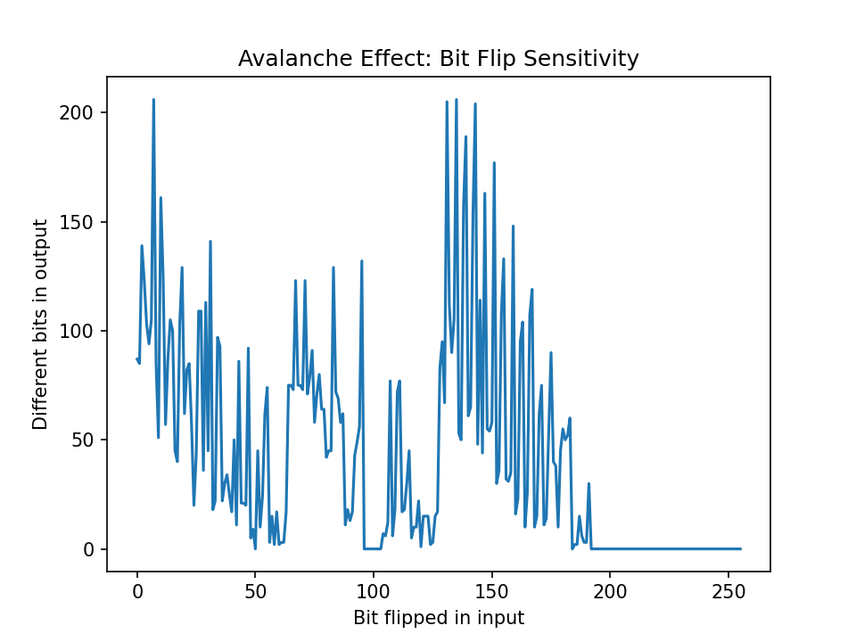
Approach - 3 - Jerald

Slide 5
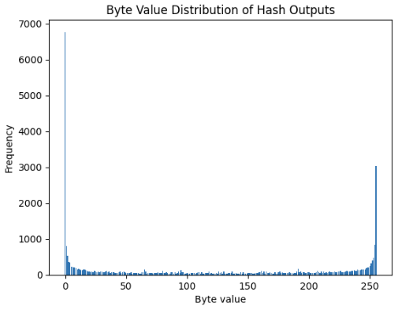
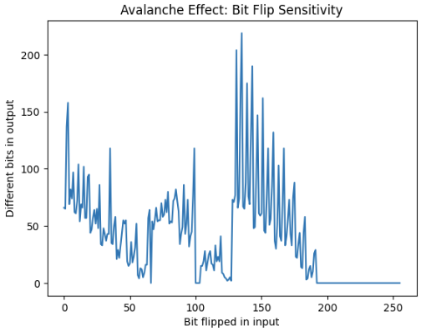

Slide 6
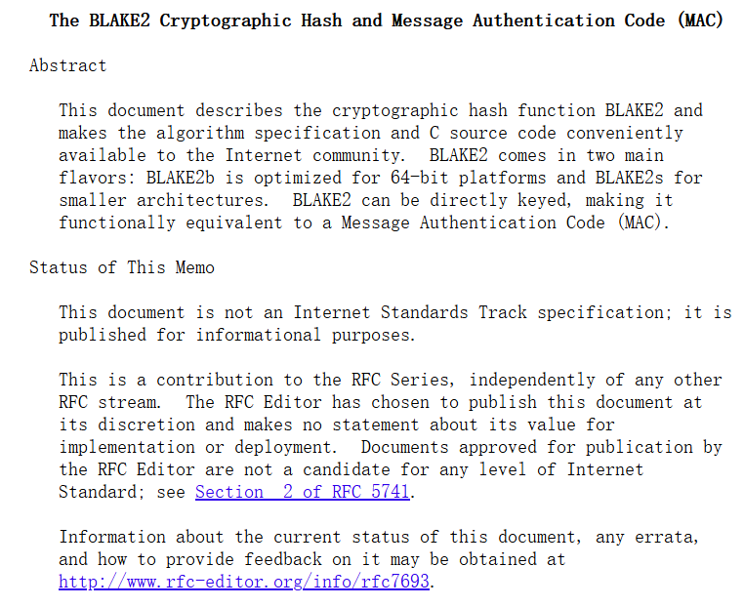
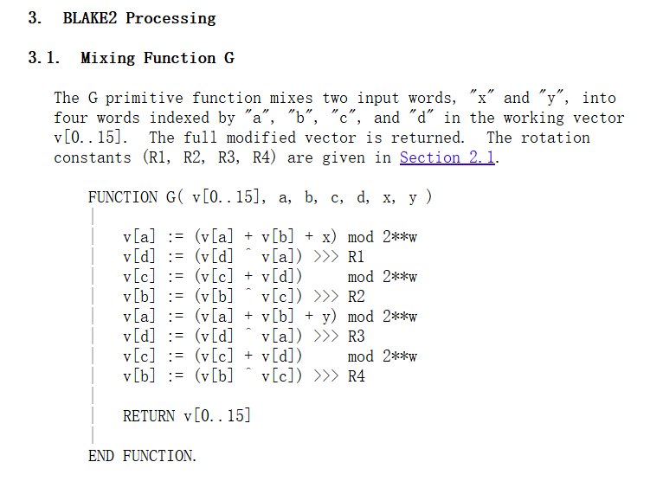
Approach - 4 - Bingsong
BLAKE2: J.-P. Aumasson et al., The BLAKE2 Cryptographic Hash and MAC, RFC 7693, IETF, November 2015. https://doi.org/10.17487/RFC7693

Slide 7
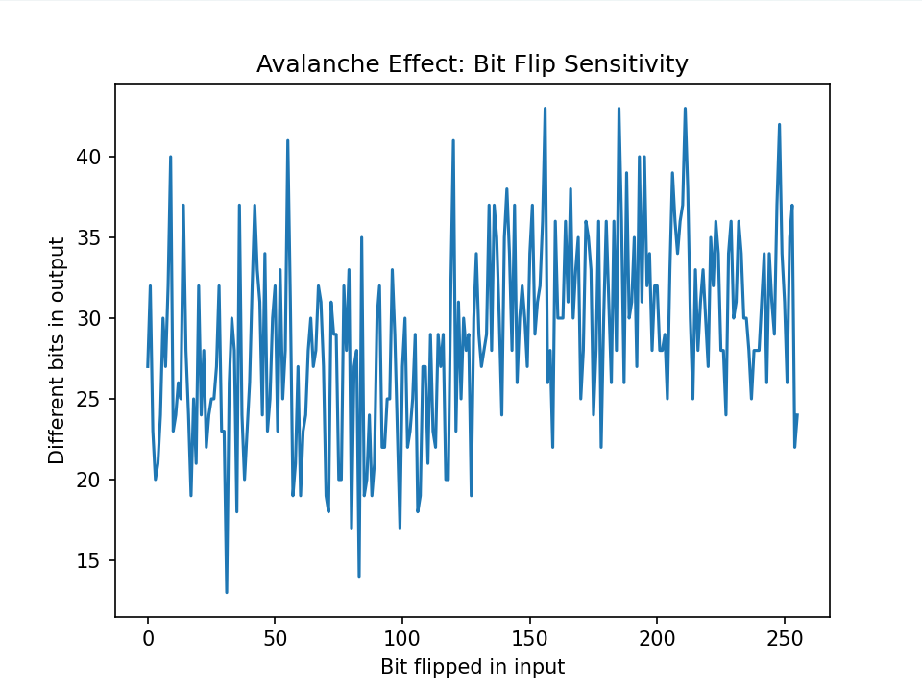
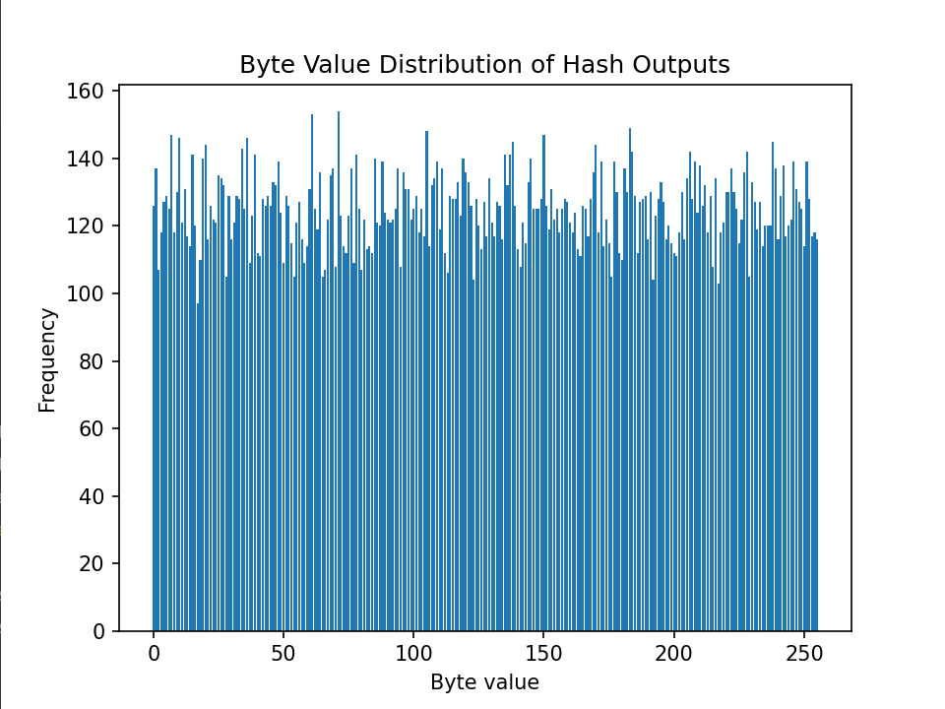

Slide 8
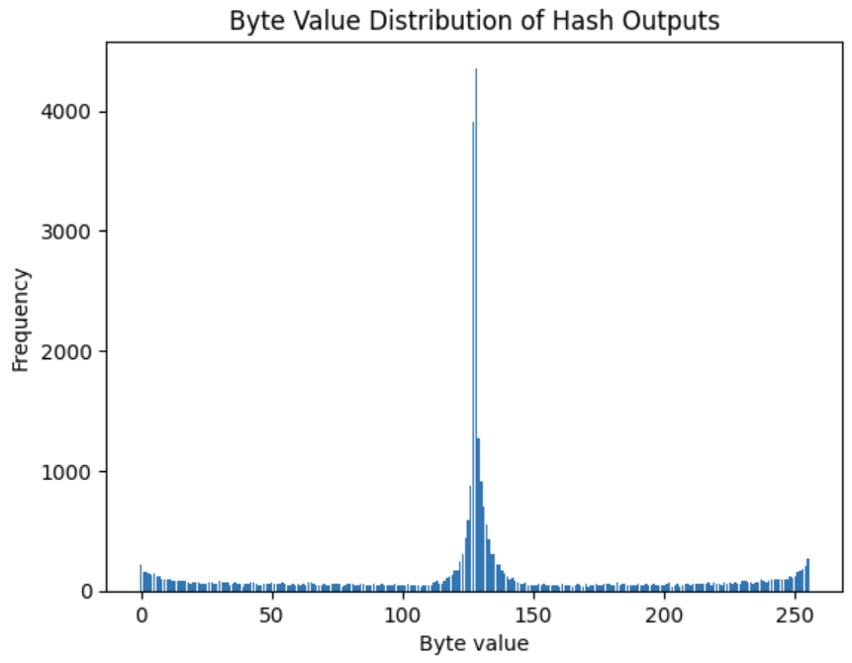
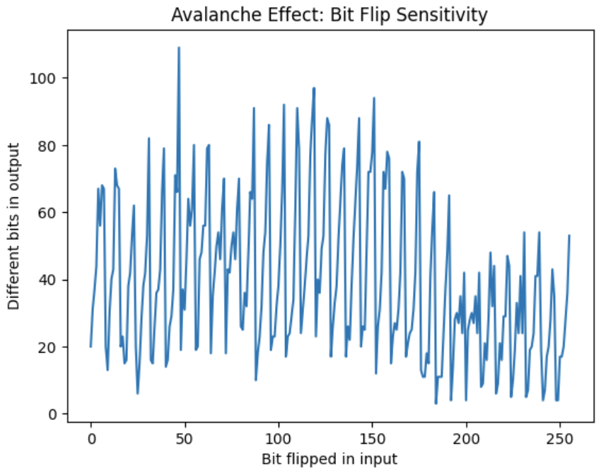

Slide 9
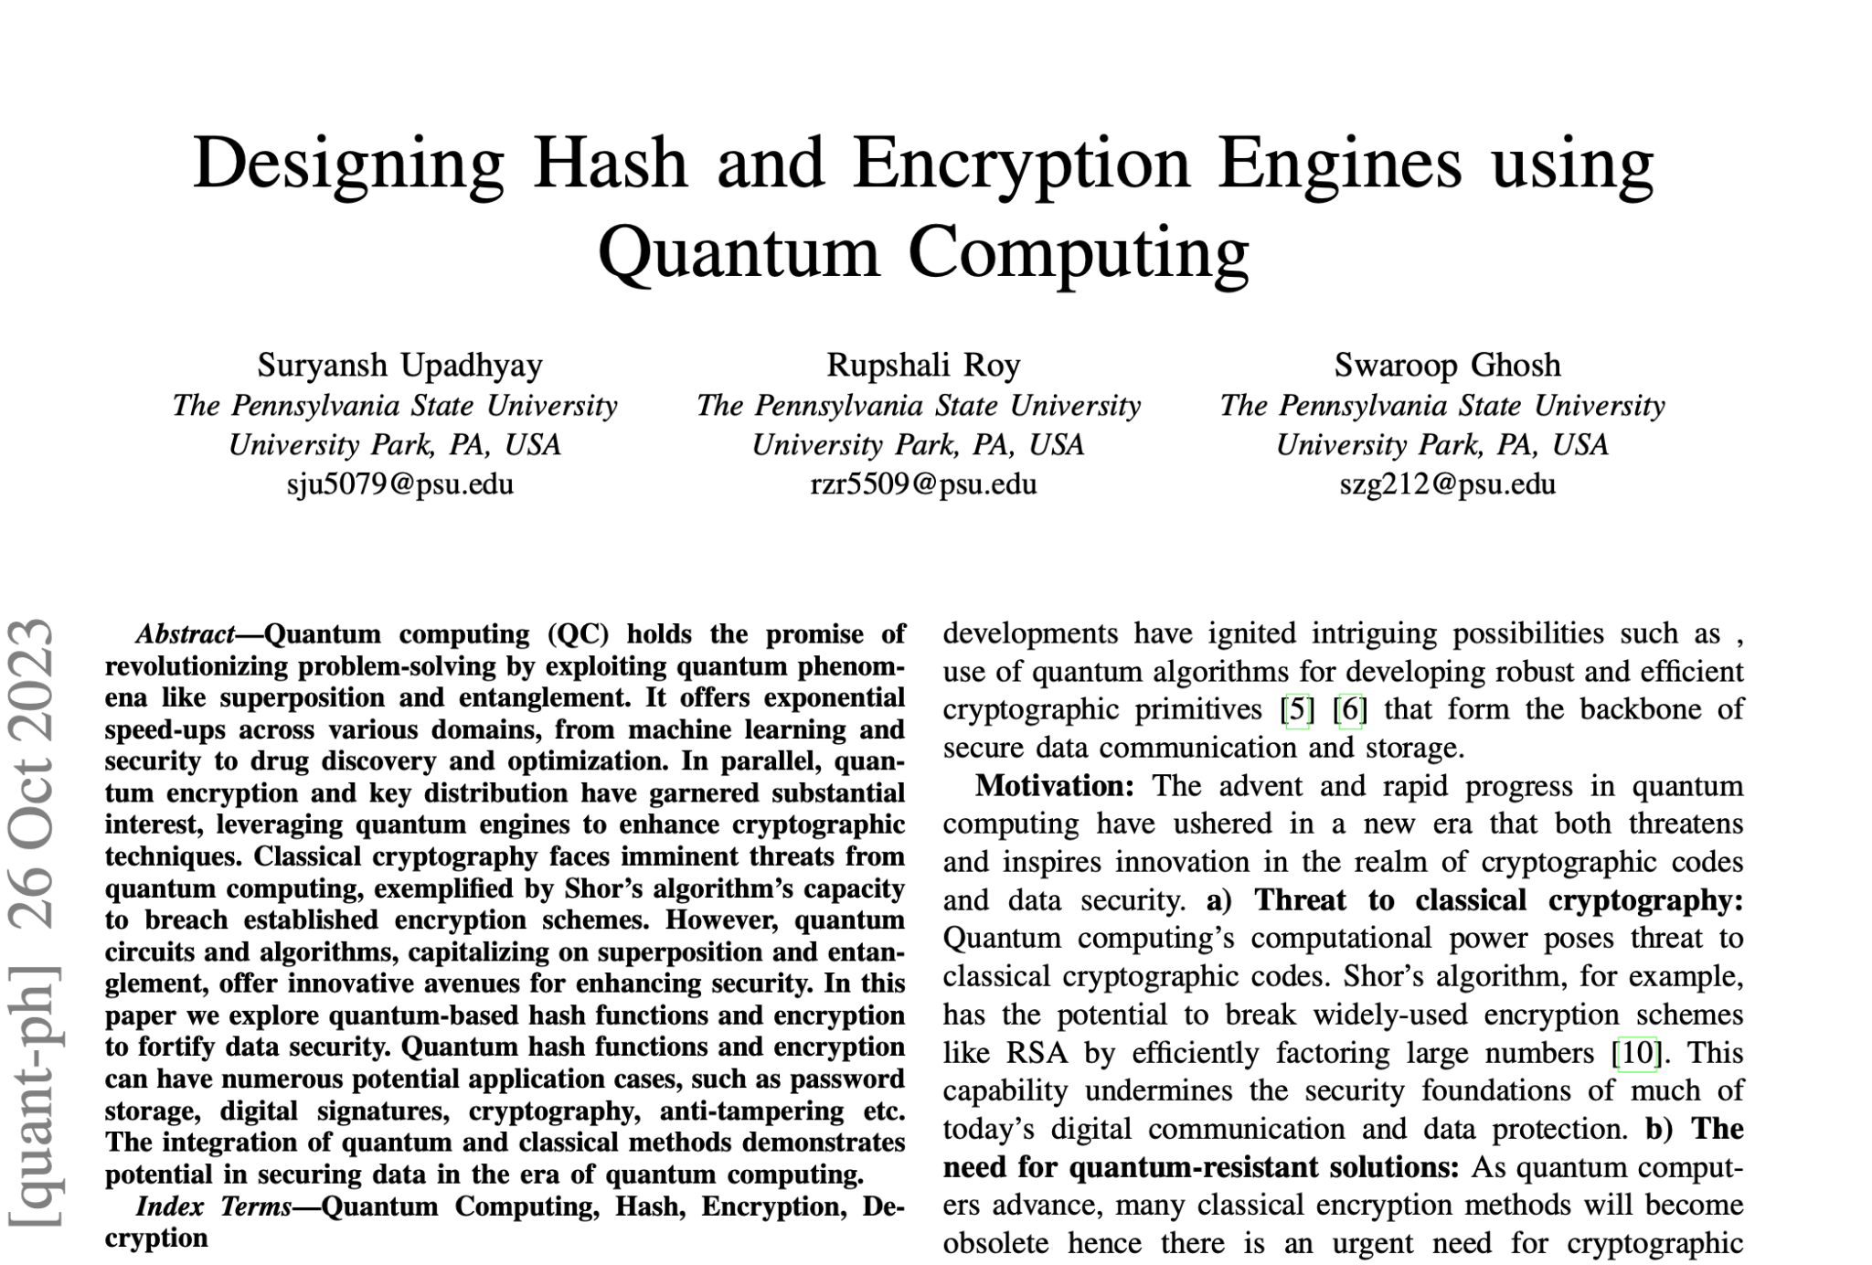
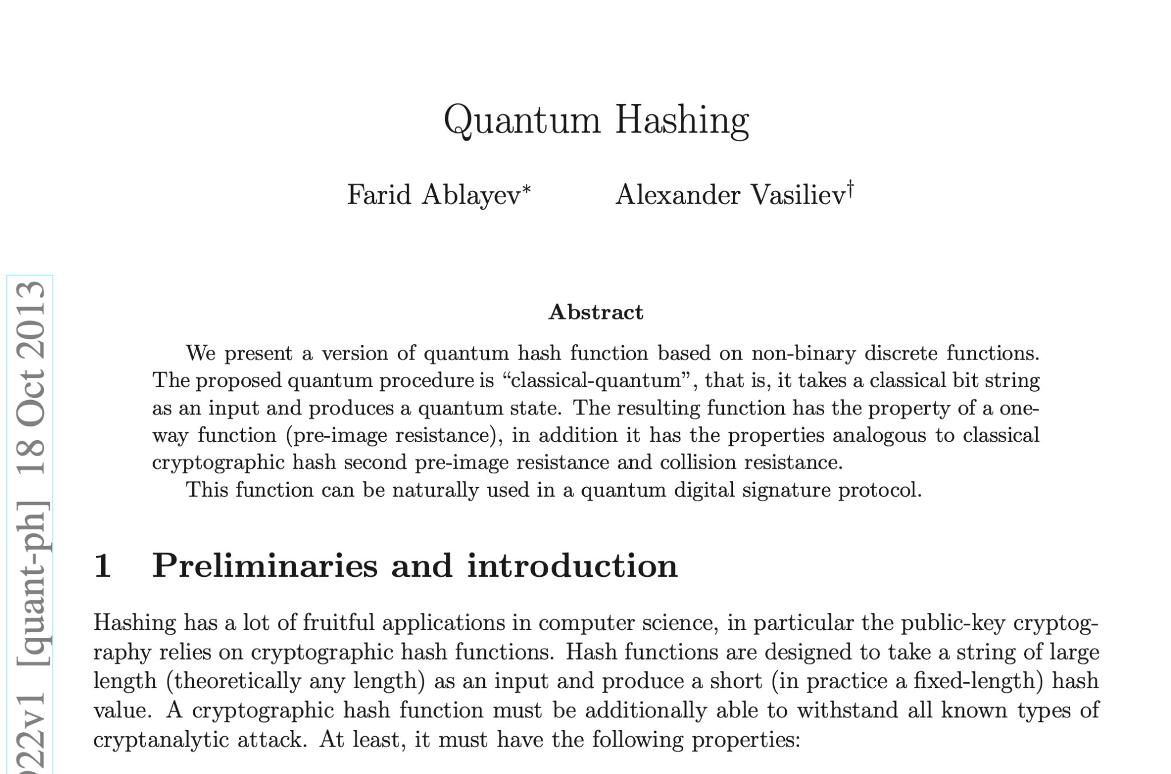
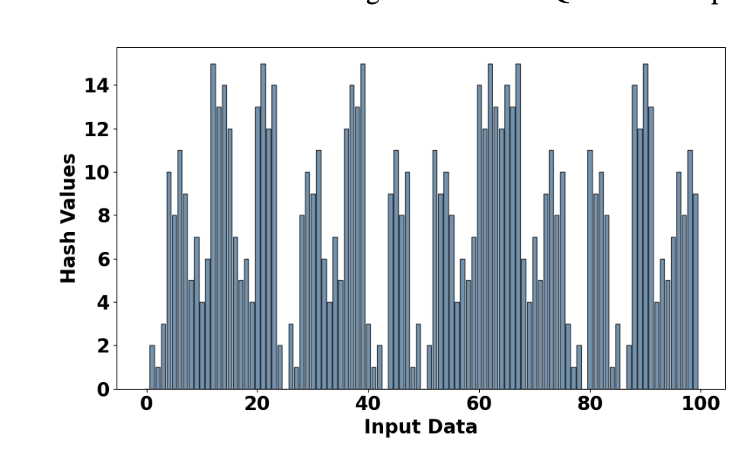
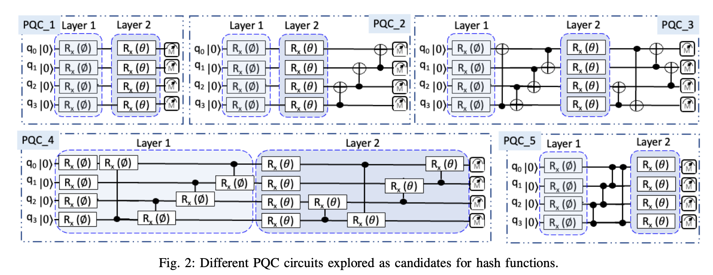
Resources Used

Slide 10
The Process
Dynamic Qubit Count →8 Qubit Circuit → 16 Qubit Circuit
Much of tinkering and border line guessing and checking hash behaviour based on gate layout
A mathematical approach was tried to derive an optimal circuit, but this quickly became unrealistic

Slide 11
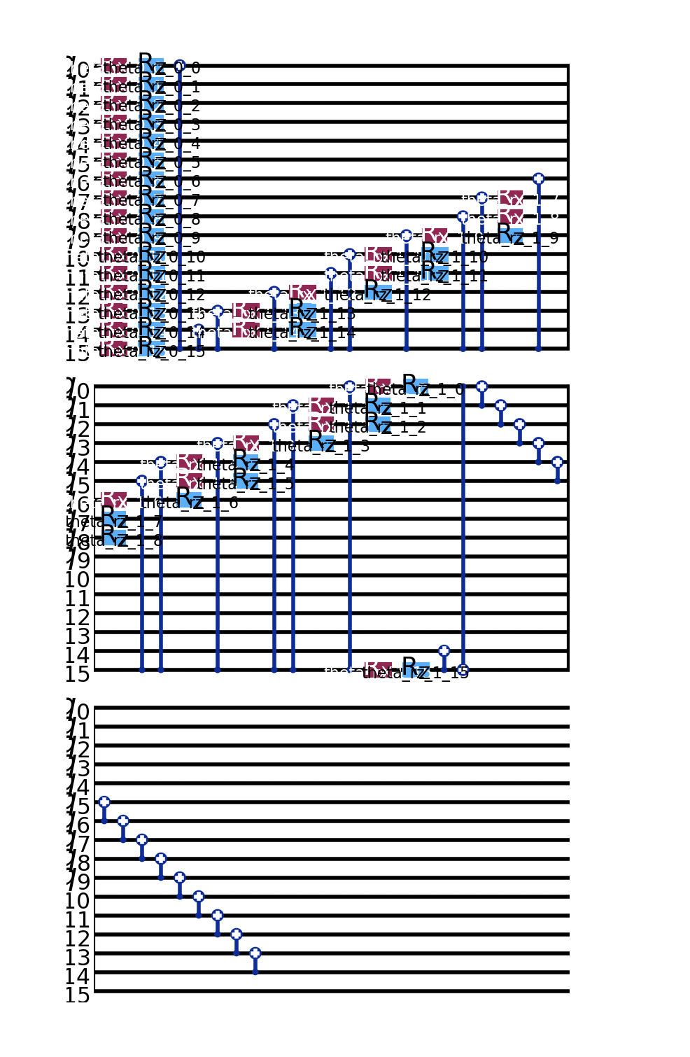
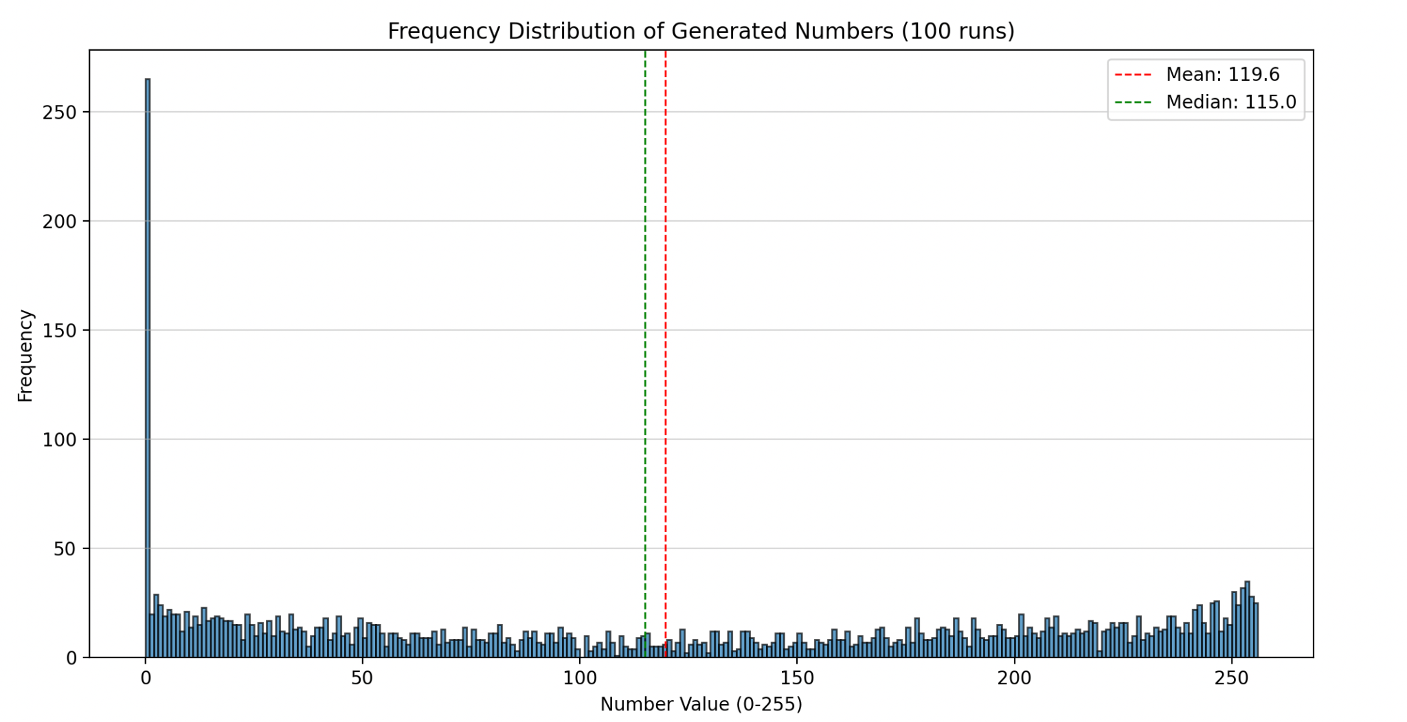
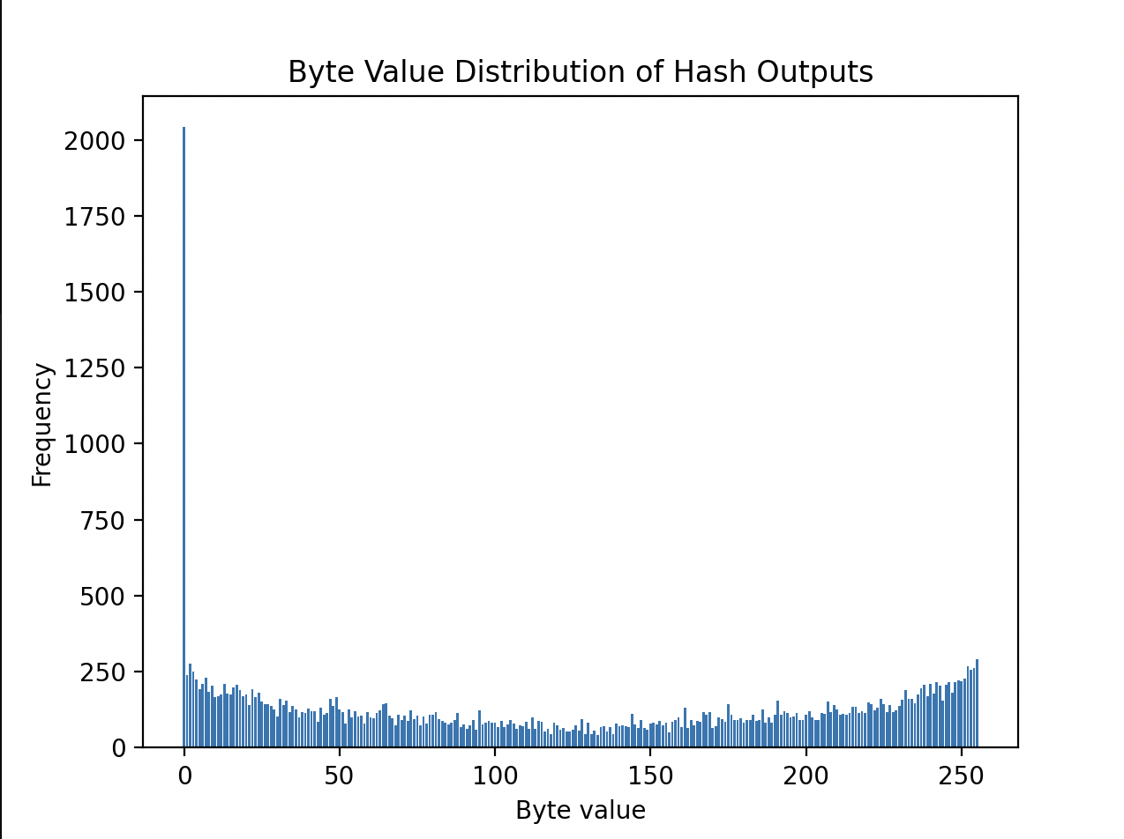
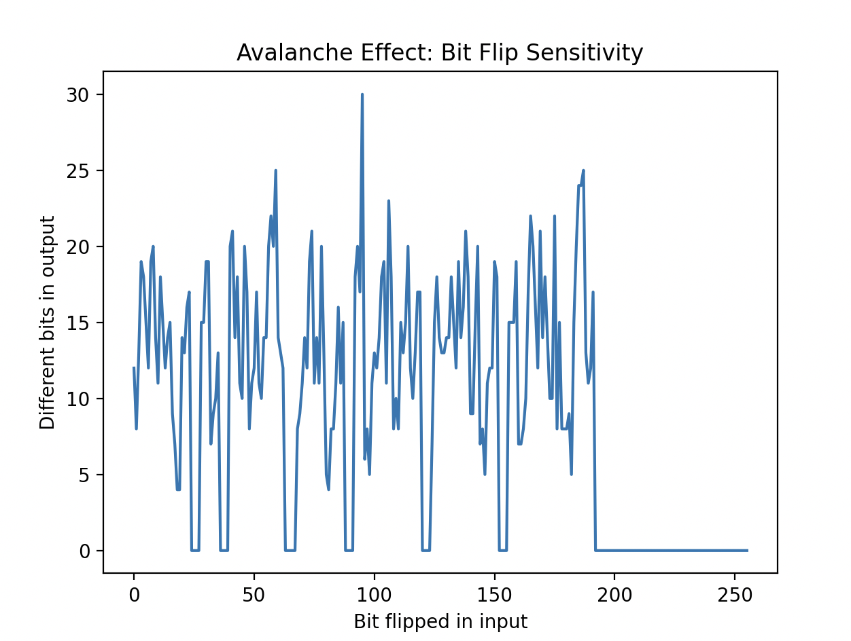
The Positives (and Negatives) of My Solution
Based upon PQC described in “Designing Hash and Encryption Engines Using Quantum Computing”
Very uniform distribution
One of the fastest functions we developed, processing 32,000 Bytes in ~360 seconds
Surprisingly low difference in Avalanche effect, significantly lowering the effect of our encryption

Slide 12
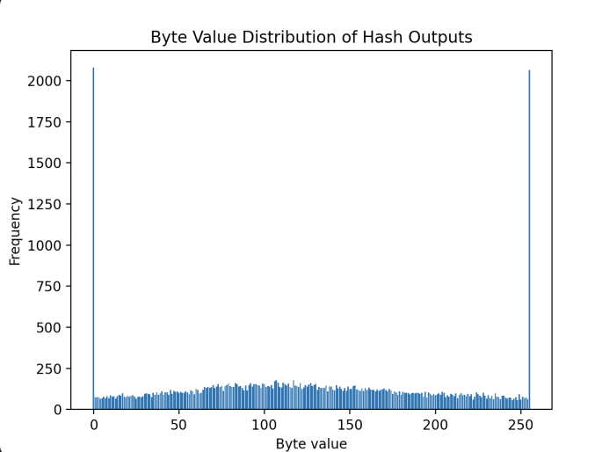
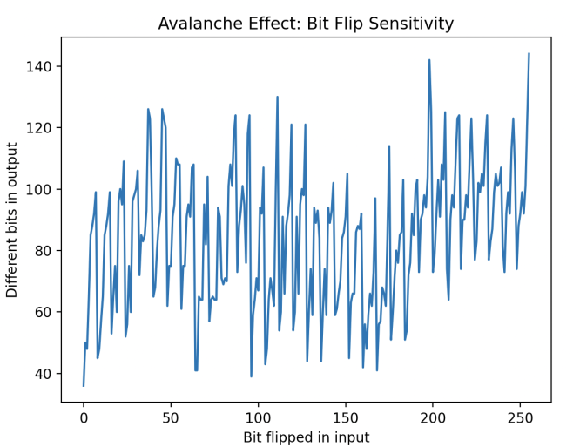

Slide 13
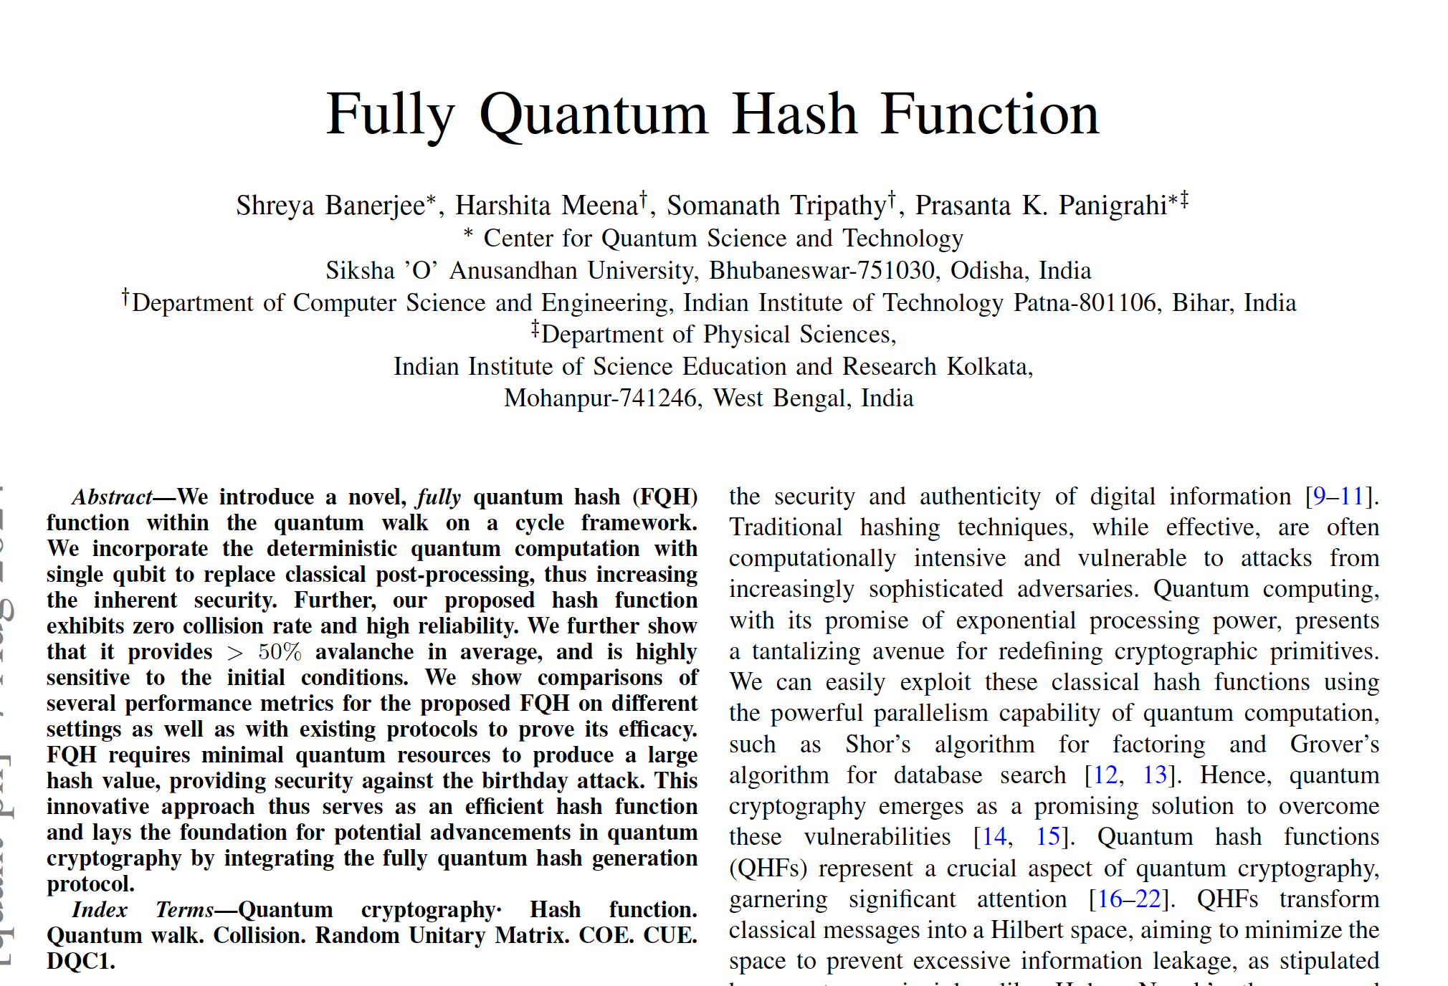
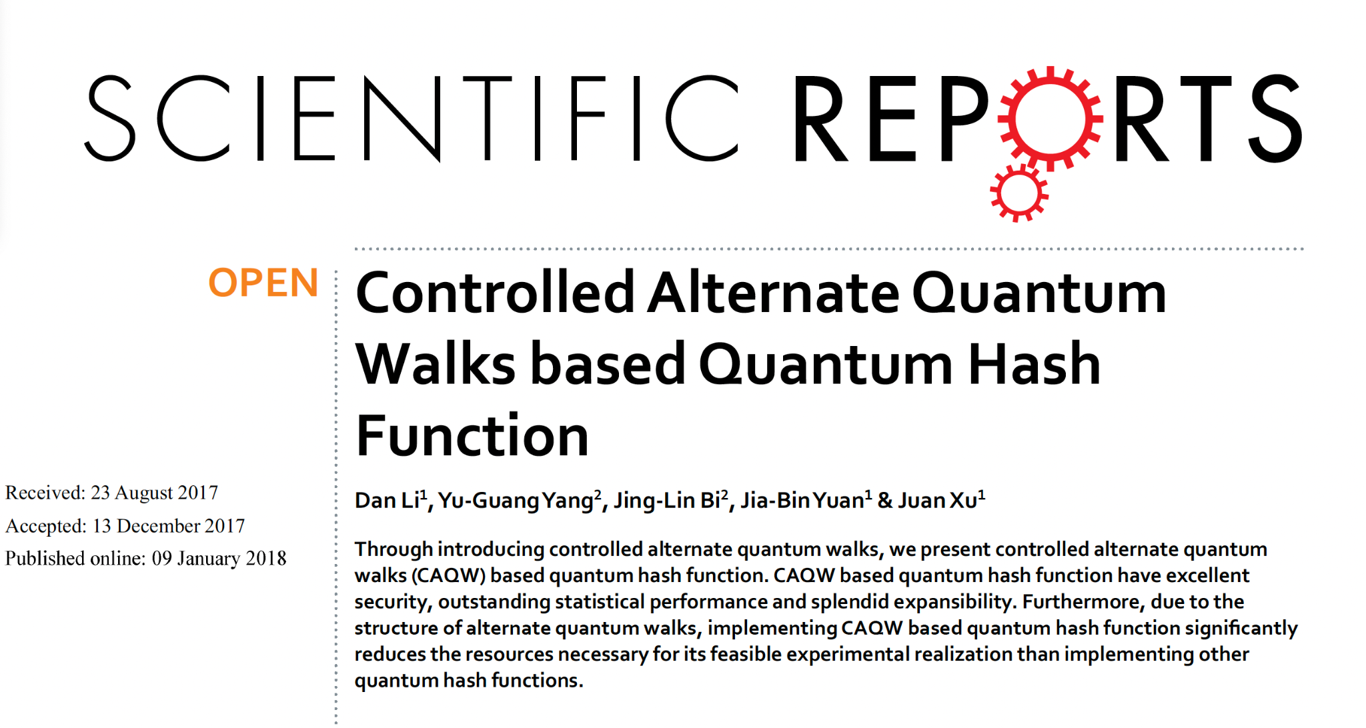
Future Steps
Incorporate Quantum Walks - further reduce collisions
Fully Quantum Hash - could yield stronger collision resistance and better avalanche properties
Notes:
Controlled Alternate Quantum Walks (CAQW)
Incorporating CAQW into the hashing algorithm may help reduce collisions further by increasing the complexity and non-linearity of the quantum transformations.
Fully Quantum Hash (2024)
This approach could yield stronger collision resistance and better avalanche properties, although practical implementation may require more mature quantum hardware

